Slide 1

Semantic Segmentation Using
U-Net and DeepLabV3+ for Underwater Image Analysis
TEAM:
Palvasha Madireddy – 24WU012081
Dharan Gangaraboina – 24WU0102210
Pavitra Sandhya Pradeep- 24WU0102234
Rishyant Chitluri – 24WU012013
Pranav Madhusudan – 24WU0102193
FACULTY MENTOR: Prof. Veeresh Biradar
Department: B.Tech AIML — Woxsen University

Slide 2
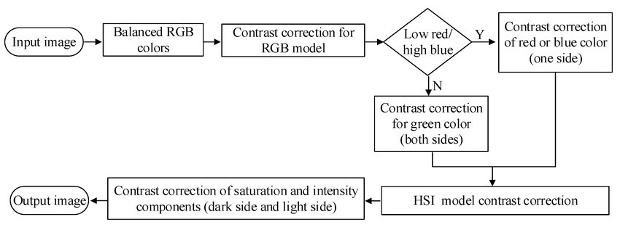

INTRODUCTION:
Underwater image analysis is essential in:
Marine biodiversity monitoring
Underwater robotics
Environmental research
Coral reef health assessment
Pollution tracking
But underwater images suffer from:
Color distortion
Light scattering
Noise & low contrast
Motion blur
So traditional computer vision methods fail.
This creates the need for deep learning-based semantic segmentation — pixel-wise classification.

Slide 3
PROBLEM STATEMENT
The problem:
Underwater images are extremely difficult to segment due to inconsistent lighting, suspended particles, color loss, turbidity, and the presence of complex marine objects. Achieving accurate boundary detection using a single model remains challenging.
Therefore:
A comparative and hybrid approach using U-Net and DeepLabV3+ is needed to improve segmentation performance.

Slide 4
PROJECT OBJECTIVES
To compare both architectures (U-Net & DeepLabV3+) based on segmentation accuracy on underwater datasets.
To develop a hybrid/ensemble model that fuses U-Net’s fine localization with DeepLabV3+’s multi-scale feature extraction.
To benchmark the performance using IoU, mIoU, Dice Score, Boundary F1-score, and computational throughput.

Slide 5
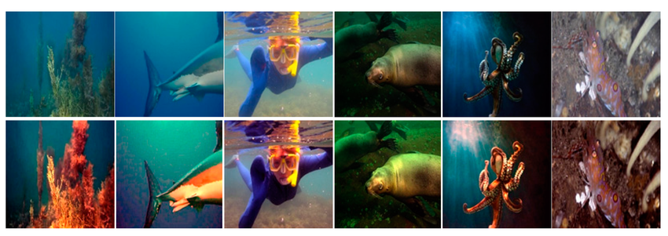
LITERATURE REVIEW
Existing Work:
U-Net is widely used in biomedical and underwater tasks due to its encoder–decoder structure and skip connections.
DeepLabV3+ improves segmentation using:
1. Atrous Spatial Pyramid Pooling (ASPP).
2. Depthwise separable convolutions.
3. Better context extraction.
Gap Identified:
  Most studies use either U-Net or DeepLabV3+ individually, but very few explore
  a hybrid or ensemble architecture specifically optimized for underwater imagery, which
  has unique distortions.
  This gap creates your novelty.

Slide 6
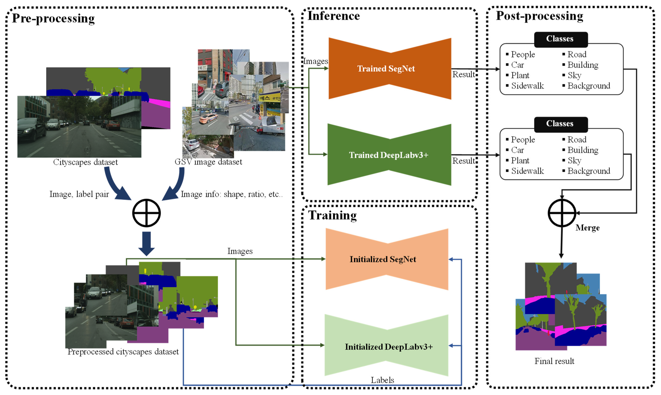
NOVELTY
What makes your project unique?
A comparative + hybrid approach
instead of using a single model.
Targeted specifically at
underwater images, which is
under-researched.
Your ensemble aims to:
  Improve object boundaries
  Produce stable segmentation
  under noise
  Increase robustness across
  datasets
  This shows CO3 (Creativity & Innovation) clearly.

Slide 7
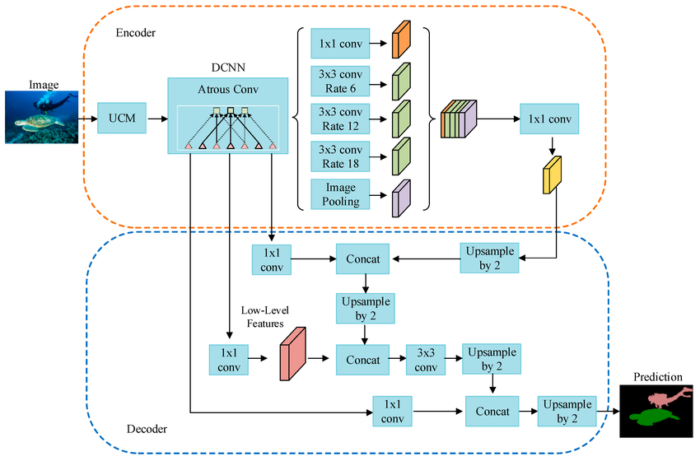
PROPOSED METHODOLOGY
Step 1: Dataset Collection
Possible datasets: SUIM, UWSeg, UIEB
Step 2: Pre-processing
Color correction, Denoising, Image resizing,
Normalization
Step 3: Train U-Net
Evaluate pixel accuracy & boundaries
Step 4: Train DeepLabV3+
Use ASPP for multi-scale features
Step 5: Hybrid Model Development
Possible strategies:Weighted averaging, Pixel-wise voting, Feature fusion
Step 6: Performance Comparison
Using metrics: IoU, mIoU, Dice Coefficient, Boundary F1, FPS (throughput)

Slide 8
BLOCK DIAGRAM (CONCEPTUAL WORKFLOW)
UNDERWATER DATASET
Pre-processing
U-Net
DeepLabV3+
Hybrid/Ensemble Model
Performance Evaluation
Final Results

Slide 9
WORK PLAN, TOOLS & TECHNOLOGIES
Tasks: | Tools:
Dataset collection & preprocessing | Python
Train U-Net | TensorFlow / Keras
Train DeepLabV3+ | OpenCV
Hybrid model design | NumPy
Performance evaluation | Matplotlib, Google Colab / Kaggle

Slide 10
CHALLENGES EXPECTED
Dataset quality variations
Training time (DeepLabV3+ is heavy)
Ensuring fair comparison
Designing an effective fusion strategy
EXPECTED OUTCOMES
A research paper-quality comparative study
A novel hybrid underwater segmentation model
Visual segmentation outputs
Benchmarked performance metrics

Slide 11
REFERENCES
Hasan, M. M., Li, Y., Yang, M., & Rahman, M. A. (2020). A Benchmark Dataset for Underwater Image Segmentation (SUIM).
arXiv:2004.01241.
Islam, M. J., Xia, Y., & Sattar, J. (2020). Fast Underwater Image Enhancement for Improved Visual Perception. ICRA. (Includes U-Net segmentation in underwater domain.)
Ronneberger, O., Fischer, P., & Brox, T. (2015). U-Net: Convolutional Networks for Biomedical Image Segmentation.MICCAI.

Slide 12
THANK YOU

